Slide 1
EXPERIMENT 7 • ADVANCED BI INTEGRATION
Executive Business Insights
& Diagnostic Analytics
Strategic evaluation of Global Superstore performance, diagnostic problem identification, and executive recommendations.
Environment
Source Dataset
Executive Focus
Microsoft Power BI Desktop
Global Superstore (51,290 Records)
Scorecards, Margins & Growth

Slide 2

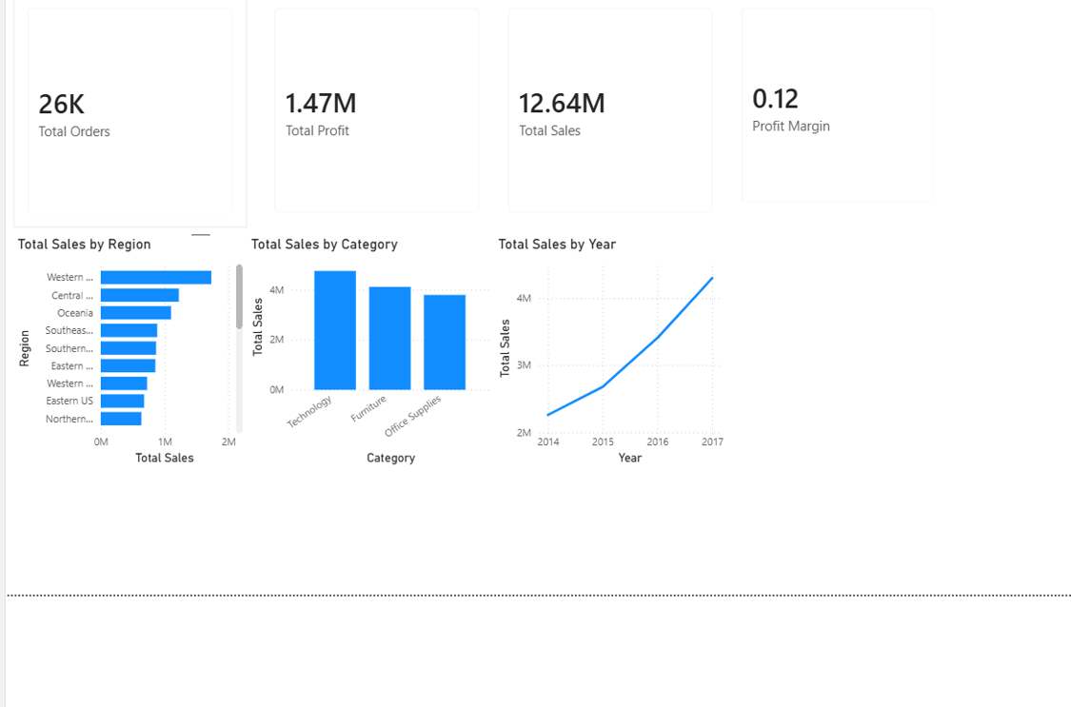
PERFORMANCE SCORECARD AUDIT
Executive Dashboard Overview & Target Tracking
TOTAL SALES
TOTAL PROFIT
TOTAL ORDERS
$12.64M
$1.47M
25,728
97.25% of Target
97.83% of Target
102.91% Achieved
Metric | Actual | Target | Achievement | Status
Sales | $12,642,501.91 | $13,000,000 | 97.25% | ▲ Partially Achieved
Profit | $1,467,457.29 | $1,500,000 | 97.83% | ▲ Partially Achieved
Orders | 25,728 | 25,000 | 102.91% | ● Achieved

Slide 3
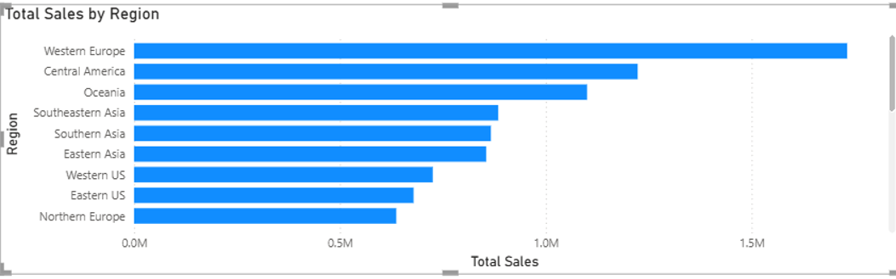

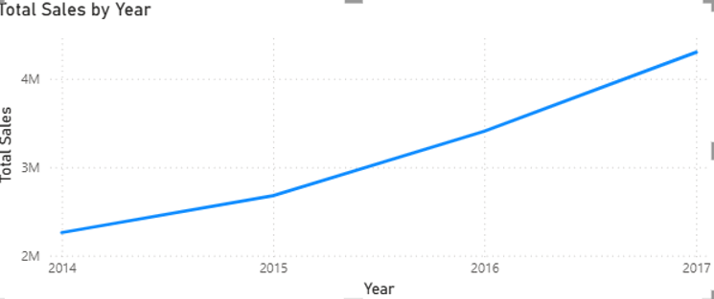
DIAGNOSTIC OBSERVATIONS
Regional Concentrations & Multi-Year Trajectory
Western Europe & Americas Lead
24.1% Compound Annual Expansion
Western Europe ($1.73M), Central America ($1.22M), and Oceania drive core revenues; secondary markets generate <1.5% each.
Revenues escalated from $2.25M (2014) to $4.30M+ (2017), supported by strong recurring order volume from enterprise clients.

Slide 4
EVIDENCE-BASED SWOT DIAGNOSTIC
Organizational Strengths vs. Operational Weaknesses
Validated Strengths
Critical Weaknesses
Technology Margin Dominance: Technology yields $4.7M+ sales and $663K profit at an industry-leading 14.1% margin.
Severe Furniture Profit Drag: Furniture produces $4.1M+ sales but only ~$285K profit (~7% margin) due to deep discounting.
High Core Geographic Density: Western Europe, Central America, and Oceania account for over 32% of total turnover.
Peripheral Distribution Drag: Canada, Central Asia, and East Africa yield <1.5% each, suffering high shipping friction.
Exceeded Order Targets: 25,728 transactions secured 102.91% of target quota with reliable B2B re-ordering.
Revenue & Profit Shortfall: Missed targets by ~2.7% ($12.64M vs $13M) due to unrestrained promotional leakage.

Slide 5
EXECUTIVE ACTION PLAN
Strategic Recommendations & Business Value
RECOMMENDATION 01
RECOMMENDATION 02
RECOMMENDATION 03
Discount Capping on Bulky Goods
Enterprise Workstation Bundles
Logistics Consolidation in 3PLs
Enforce automated 10% maximum discount ceilings on Tables, Chairs, and Bookcases.
Bundle high-margin Tech accessories with Home Office ergonomic seating for remote B2B accounts.
Shift distribution in peripheral markets (Canada, Central Asia) to localized third-party partners.
Expected Benefit
Expected Benefit
Expected Benefit
Recaptures ~$65K+ lost margin; lifts Furniture profit to ~10.5%.
Expands segment revenue by 15–20% at superior 11.9% margin.
Decreases cross-border freight overhead by 12–18%.

Slide 6
EXECUTIVE CONCLUSION
Driving Strategic Growth Through BI Governance
Integrating diagnostic Power BI analytics converts transactional data into actionable management control. Enforcing discount discipline and scaling high-margin verticals ensures target achievement and sustainable enterprise profitability.
30-DAY ACTION
60-DAY ACTION
90-DAY ACTION
Implement Power BI DAX alert rules for transactions exceeding 10% discount on heavy items.
Roll out enterprise B2B Home Office product bundles with volume-based pricing tiers.
Transition peripheral distribution to regional 3PL partners to optimize unit economics.

